Slide 1
Getting started with AI
Building a simple image recognition app

Slide 2
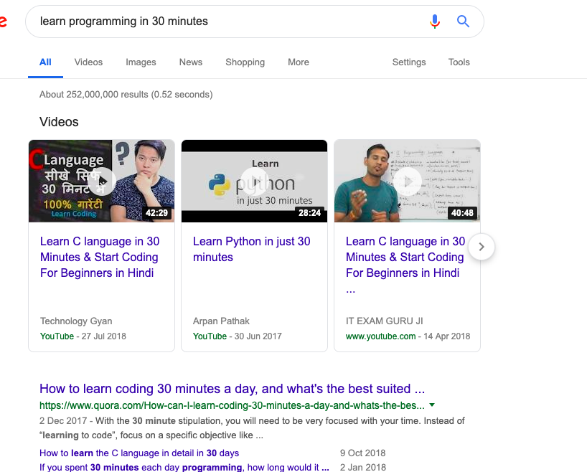
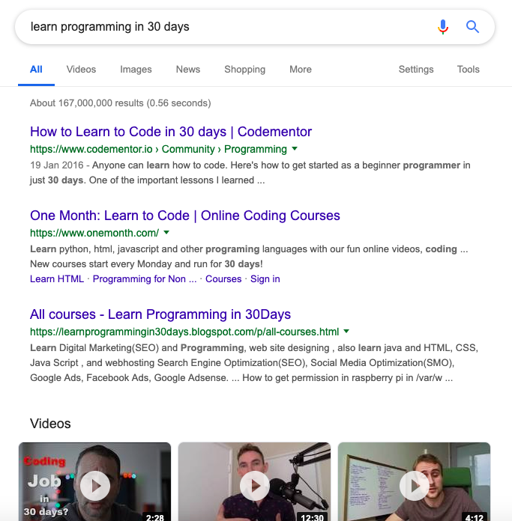
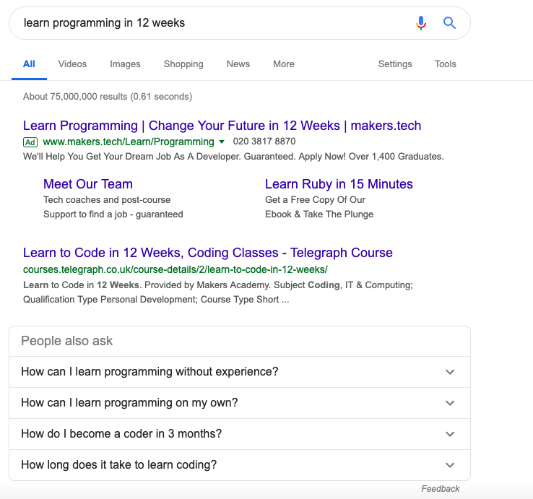
Let’s talk about learning (Exhibit 1)
“Learn programming in 30 mins/30 days/ 12 weeks..

Slide 3
Let’s talk about learning (Exhibit 2)
“Teach yourself programming in 10 years” – Peter Norvig
Gladwell explains that reaching the 10,000-Hour Rule, which he considers the key to success in any field, is simply a matter of practicing a specific task that can be accomplished with 20 hours of work a week for 10 years.

Slide 4
The reality
Most fields require 250-300 hours of practice for us to have a sufficient level of expertise to be able to useful things with them
1 hour a day means all you need is just a year to become an ‘expert’ at artificial intelligence.
Go to begreat.me for fun ways to play around with how much time we waste.

Slide 5
AI Math PRIMER: EASY Mode

Slide 6
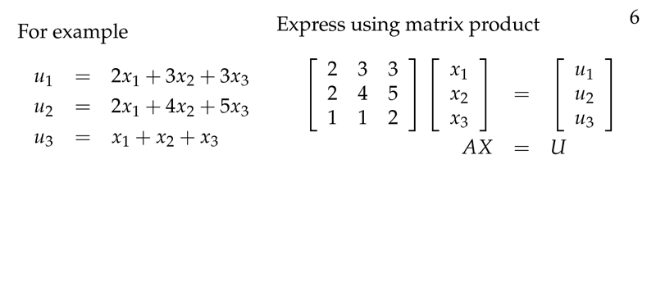
AI Math PRIMER: Intermediate Mode

Slide 7
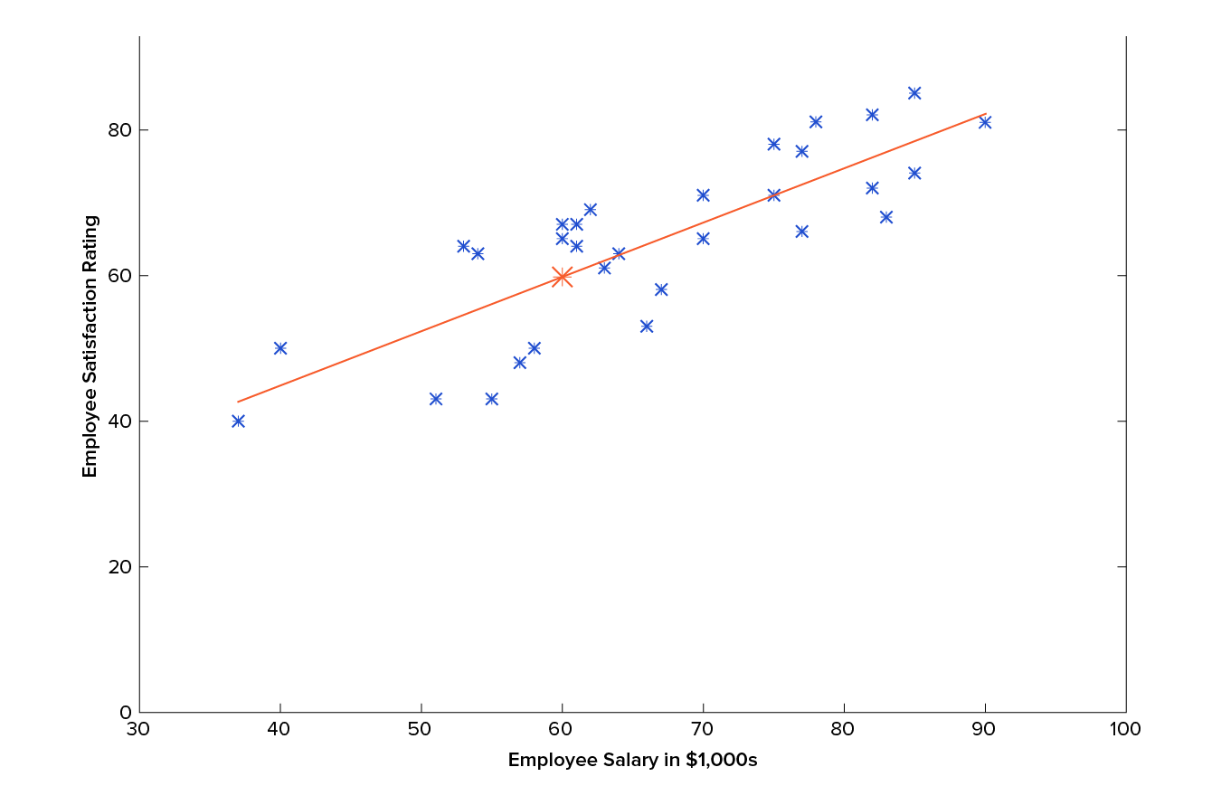

AI Math PRIMER: HARD Mode

Slide 8
AI – The Self-LEARNING curriculum
Figure out your objective for learning this and work backwards from that
Consistency is more important than binging
Do not get lost in ‘tutorial purgatory’
Give yourself mini-project to ensure that you are building knowledge
Find someone to ‘pair-learn’ with and join online communities
Focus on shipping and working with large public datasets
Subscribe to newsletters
Listen to podcasts
Get on tech twitter

Slide 9
Getting started
Housekeeping items before you dive into any technical tutorials:
Knowledge of linear algebra (Check out Gilbert Strang’s MIT Course if you don’t know where to start or pick anything else on ClassCentral)
You might also want to check out Microsoft’s Essential Math for Machine Learning course which is available on edX
Understand basic syntax of Python (browse the PyData ecosystem and libraries)
Basic knowledge of APIs and libraries
Read Toptal’s ‘An Introduction to Machine Learning Theory and it’s applications: A Visual Tutorials with Examples’
Google ‘introduction to..’ for the following terms and read non-technical guides for the following:
Linear Regression
TensorFlow
Pytorch

Slide 10
Learning pathways - theory
Fast.ai
Stanford Online (search for archived courses via ClassCentral)
MIT Open Courseware
Coursera: any Andrew Ng course; for generalists looking to get a overview, Andrew Ng has a course called ‘AI for Everyone’
edX
Udacity NanoDegrees
Codecademy Pro
GitHub
Kaggle
FreeCodeCamp

Slide 11
Books to Read
Textbooks:
AI: A Modern Approach by Stuart Russell and Peter Norvig
Deep Learning by Ian Goodfellow and Yoshua Bengio
Superintelligence by Nick Bostrom
Python Machine Learning by Sebastian Raschka
Foundations of Machine Learning – Mehryar Mohri
Fun Reads:
The Big Nine: How the Tech Titans and Their Thinking Machines Could Warp Humanity
AI Superpowers: China, Silicon Valley, and the New World Order
Any good Sci-Fi books: Neal Stephenson, Isaac Asimov, Philip Dick

Slide 12
Newsletters to SuBSCRIBE TO
Deep Learning Weekly
The Exponential View
The Algorithm (MIT)
PaperswithCode
Import AI
Google/Amazon AI Blogs
KDNuggets News
Inside AI
NLP News
Data Elixir

Slide 13
Podcasts to LISTEN to
Shows:
Talking Machines
The Exponential View
This Week in Machine Learning and AI
Artificial Intelligence in Industry with Daniel
Machine Learning Guide
The AI Podcast – NVIDIA
Practical AI
Linear Digressions

Slide 14
AI Twitter
Sebastian Thrun @SebastianThrun
Andrew Ng @AndrewYNg
Adam Coates @AdamPaulCoates
Demis Hassabis @DemisHassabis
Ian Goodfellow @goodfellow_ian
Andrej Karpathy @karpathy
Dan Jurafsky @jurafsky
Fei-Fei Li @drfeifei
Christopher Manning @chrmanning

Slide 15
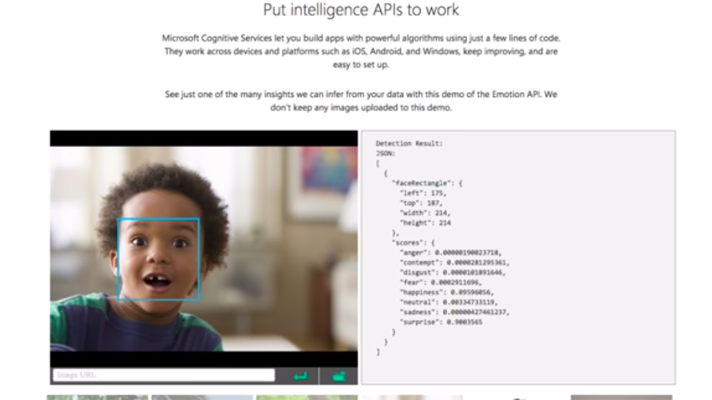
Now let’s build something..
We will build a basic Image Recognition application
The user will take a picture with their camera and our app will attempt to classify it.
We will use Thunkable, a visual code-builder for our demo app.
Also, check out Scratch and Runway ML

